Slide 1
Internal Controls
Creating an Internal Control Structure to Support a School District’s Operations.

Slide 2
Objectives
Identify areas of high risk in student activities and district processes.
Detail appropriate internal control protocol.
Describe how to implement oversight and controls at both the school and district level.
Next Practices

Slide 3
The Importance of Internal Controls around Student Activities
Effective controls reduce the risk of asset loss and help ensure that data is complete and accurate, financial statements are reliable and all laws and regulations are complied with.

Slide 4
Cash Controls – District Oversight
Compare bank deposits to cash receipts records. Verify the tender type and totals agree.
Review voided transactions to ensure they are supported and legitimate.
Look for unusual/frequent void activity by employee or school.
Perform surprise cash counts.
Review revenue levels for unusual increases or decreases.
Review for gaps in sequential cash receipts and checks.

Slide 5
Cash Controls - Permissions and Separation of Duties
Safeguard and limit access to receipts awaiting deposit.
Change the safe combination when there is a change in key personnel. Limit access to the safe.
Same person receipting money isn’t reconciling the bank statement or writing checks.
The person entering fines/fees does not have access to waive the fines/fees.

Slide 6
Cash & Check Receipt Form

Slide 7
Petty Cash & School Checking Accounts
District policy for cash accounts & what payments are allowed (don’t pay employees or contracted services).
At least two authorized check signers.
Monthly reconciliations.
District online access to bank statements.

Slide 8
Fundraisers & Gate Receipts
Fundraisers are pre-approved.
Seed money is counted and signed off as received & returned.
Pre-numbered tickets or receipts are always used when money is collected.
Receipts are always noted by type of tender. Cash, check, credit.
Money counted at the end of each activity and when turned in.
Money is stored in an approved and secure location before and after the event.

Slide 9
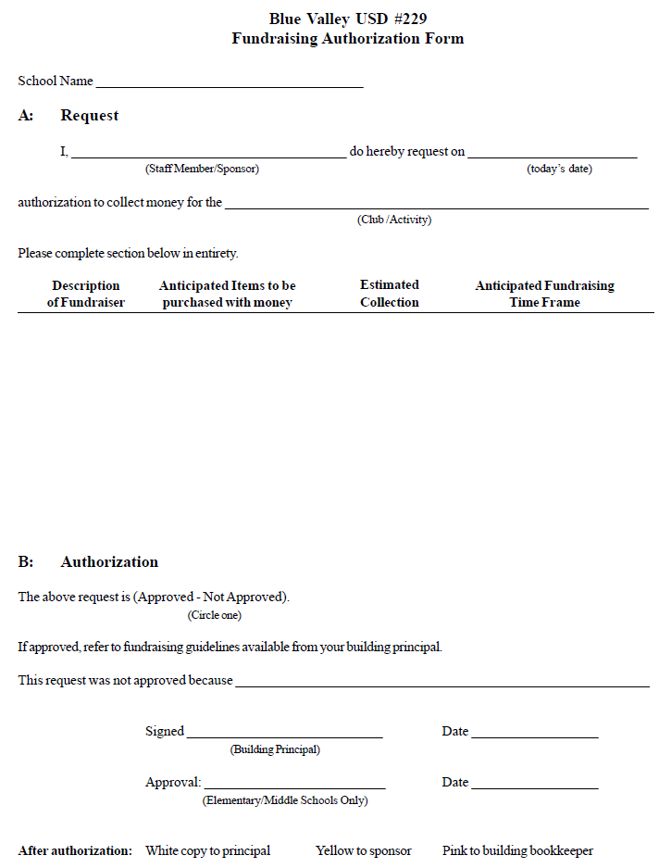
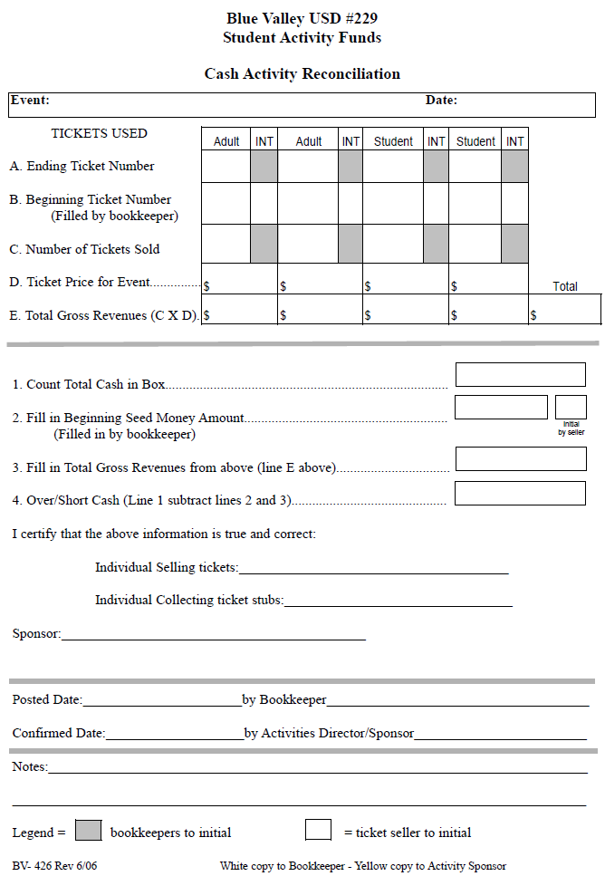
Fundraiser & Gate Receipt Forms

Slide 10
Revenue Reports – District Oversight
Review receipt adjustments or write-offs.
Follow up on unusual over/short cash receipting activity.
Do cash deposits differ from normal patterns in previous months/years.
Understand the internal controls in place in your accounting software (receipt posting dates, ability to reprint receipts, user security, audit reports, etc.)

Slide 11
Revenue Reports – District Oversight
Perform a periodic “look back” at revenues. Do they make sense given your understanding of the operations?
Review receipt sequence. Are receipts used in sequential order? Are all the receipt numbers accounted for?
Review bank reconciliations. Are they timely? Do reconciling items make sense? Is there separation of duties from who receipts and reconciles?

Slide 12
Other – District Oversight
Policy on contracts being signed by authorized district representative.
Vendor vs. Employee guidelines are followed for tax implications.
Smart Snacks guidelines are followed for fundraisers.
Health permits and cards are on hand for student stores, concessions and other events.
Parent permission slips are on hand for all students fundraising and collecting money.

Slide 13
Other – District Oversight
Monthly Review of Activity Detail Reports approved by Teachers/Sponsors.
Train Coaches and Advisors annually on district policies around fundraisers, cash collections, sales tax, etc.
Confirm merchandise isn’t delivered to a staff member’s home.

Slide 14
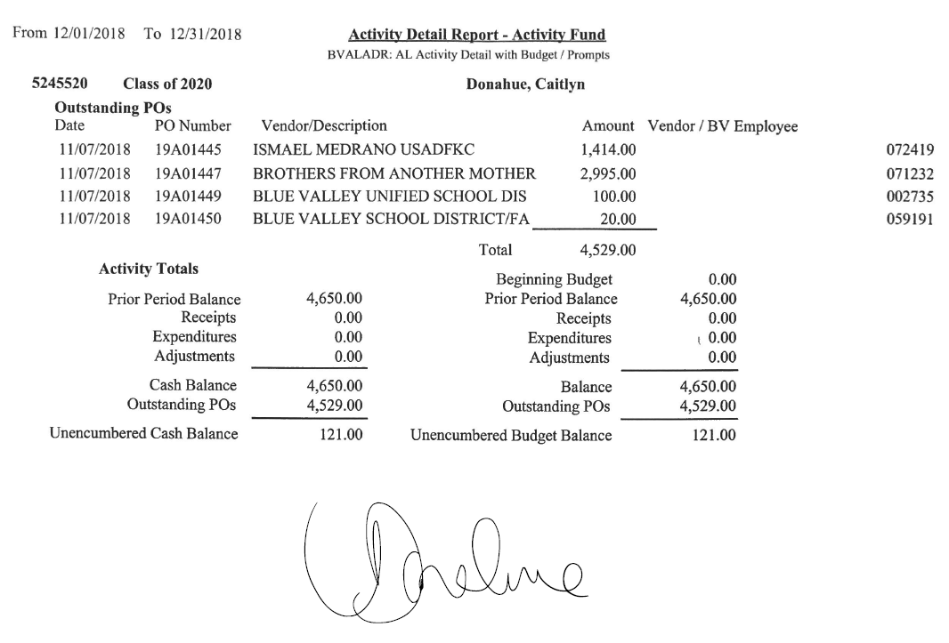
Monthly Activity Detail Report Approval

Slide 15
Expenditures
Expenditures are used for allowable activities.
Purpose of expenditure is documented and approved.
All School District policies are followed for: Purchase orders, approvals, bids or quotes.
Procedures are in place to ensure no club, sport or activity spends more funds than it has available.

Slide 16
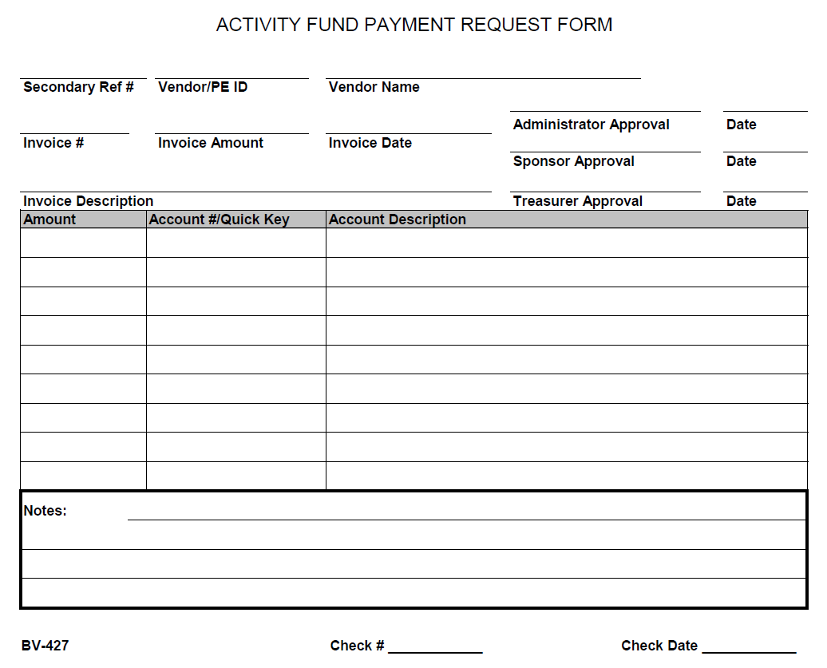
Activity Fund Payment Request Form

Slide 17
Procurement Cards
Annually cardholders should sign or otherwise acknowledge that they have reviewed the district policy on P-cards – ensures employees know what’s appropriate and what isn’t.
Check out process – employees sign out the card with expected dollar amount and vendor name.
Prior approval or approval after purchase.
Cards are kept in a secure location with limited access.
Itemized Receipts – Receipts are returned in a timely manner with adequate support (Meals – roster of who ate, reason for meal, etc.).
Monthly Reconciliation Review – ensure expenditures are appropriate and adequate documentation is attached.

Slide 18
Private Money & Parent Groups
Funds raised as Private Money are restricted to use as stated by donor.
PTA & Booster’s money is not co-mingled with district funds.
District is not storing merchandise or money for an outside organization.
District staff does not hold an executive role in PTA or Booster Club.
Parent Groups and Booster Clubs are registered with the state, if applicable.

Slide 19
Inventory Controls
All equipment/goods purchased with student activity funds is annually inventoried and reconciled.
All spirit wear is secured and periodically inventoried.
Procedures are followed for maintaining inventories in student stores.

Slide 20
Next Practices
Data analytics
Expenditure trends
Journal Entry analysis
Payroll
Classroom – Teacher effectiveness and student achievement
Other?

