Slide 1
2018-2019 Negotiations Training
Bargaining for Better Schools
KASB Regional Training
Spring 2018
Luke Sobba
KASB Attorney

Slide 2
COMPLETION OF TRAINING LINK
Type the link below in your browser and complete a few questions and you will receive an email confirming completion of the 2018-2019 negotiation requirements per K.S.A. 72-2228. Please send a copy of the email confirmation to your school board clerk for recordkeeping purposes.
The training certification link is kasb.org/LegalCert

Slide 3
What We’ll Cover
Negotiation Basics
Common positions and best responses
Prohibited Practices and how to avoid them

Slide 4

The Top 10 questions you need to ask before entering negotiations

Slide 5
Why do we Negotiate? What is the Goal?
#1

Slide 6
Professional Negotiations Act
K.S.A. 72-2218 et seq.
  Original bill passed in 1970
  In 1977, significant amendments were made to the PNA, including:
    Adding the definition of “terms and conditions of professional service”;
    Excluding administrators from the PNA;
    Listing what constituted a prohibited practice;
    Establishing impasse procedures;
    Making negotiation meetings subject to the Kansas Open Meetings Act.
  PNA enforced by the Secretary of Labor
  2016 Changes to PNA Act

Slide 7
Seek Consensus on Professional Expectations
Excellent Teachers are Critically Important
Harvard and Columbia Study (2012):
  A poor teacher has the same effect as a student missing 40 percent of the school year.
  Teachers impact achievement 2 to 3 times more than any other school factor, including services, facilities and even leadership.
Through negotiations, provide incentives for excellent teachers to work in your district
  Pay, benefits, work conditions, incentives to improve

Slide 8
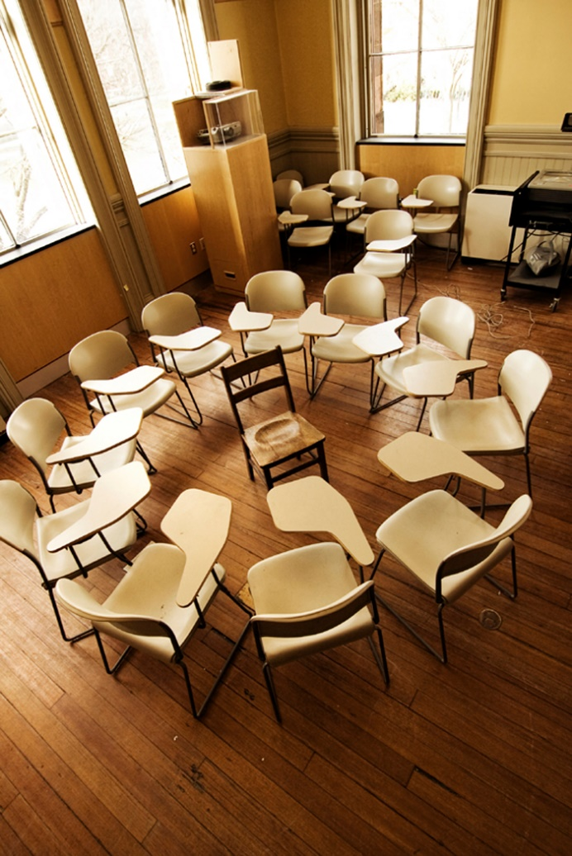
Recognizing the Bargaining Unit
Exclusive representation
Selected by a majority of the professional employees
Exclusive representative of all professional employees
Board not required to negotiate until bargaining unit recognized

Slide 9

Casting Ballots
All teachers get to vote!
  Must be ratified by both the board of education and the teachers.

Slide 10
Board’s Goals for Negotiations
Agree to compensation package that allows the district to attract and retain excellent teachers.
Negotiate terms and conditions that promote healthy work and learning environment.
Manage finances within the districts means and to promote its best interests.
Make choices on mandatory topics.
Preserve the Board’s management authority on non-mandatory topics.

Slide 11
How does the negotiations process begin?
#2

Slide 12
Beginning the Process
Notice Letter – March 31
  Meetings subject to KOMA
  Contract may be up to 3 years
  Compulsory items
  Compensation and amounts
  of work
  Plus 3

Slide 13

The Board’s Notice Letter
Notices shall be in writing
Shall contain in reasonable and understandable detail the purpose of the new or amended items as desired
K.S.A. 72-2228(a)

Slide 14

Preparation for Negotiation
Begin early
Have Board and School Attorney review negotiated agreement in January and February
Annual review critical for Board to maintain management rights

Slide 15
What are we required to negotiate?
#3

Slide 16
Terms and Conditions of Professional Service
K.S.A. 72-2218(l)(1)
  List of topics board must negotiate
  Has been interpreted and expanded by the courts

Slide 17
Number of Items That Must be Negotiated Each Year
Boards and teacher associations must annually negotiate compensation and hours and amounts of work.
  Compensation is defined as salary and wages, supplemental contract salaries, and overtime pay.
In addition, each side may select up to three (3) additional items from the list of mandatory topics found in the PNA’s “terms and conditions of professional service.”
All other topics listed in the PNA become permissive and may be discussed if both sides want to.
These limiting provisions do not apply to negotiations of a first-time contract between a board and a newly formed bargaining unit.

Slide 18
K.S.A. 72-2228(b)(1)
Upon entering negotiations pursuant to this section, the parties shall negotiate compensation of professional employees and hours and amounts of work. In addition, each party may select not more than three additional terms and conditions of professional service from the list described in K.S.A. 72-2218(l)(1), and amendments thereto, for negotiation. All other terms and conditions of professional service described in K.S.A. 72-2218(l)(1), and amendments thereto, shall be deemed permissive topics for negotiation and shall only be negotiated upon the mutual agreement of the parties.

Slide 19

Mandatorily Negotiable Topics
  Pay for supplemental contracts
  Early retirement benefits
  Fringe benefits (pay for insurance)

Slide 20

Mandatorily Negotiable Topics
Leave
  Sick
  Personal
  Holidays
  Leave of Absence
  Sabbatical
  Sick Leave Bank

Slide 21
Mandatorily Negotiable Topics
Certain Association Rights
  Voluntary Payroll Deductions
  Use of Building for Meetings
  Use of Bulletin Boards
  Use of School Mail System
  Association Leave
  Dissemination of Negotiation Information

Slide 22

Mandatorily Negotiable Topics
Other mandatory topics
  Reduction in Force procedure
  Grievance procedure
  Form of the contract
  Evaluation procedure

Slide 23
What if we decide we don’t want to negotiate with the teachers?
#4

Slide 24
Prohibited Practices
You may get a prohibited practice filed against the board
Must negotiate in “Good Faith”
Refusal to negotiate mandatory topics = prohibited practice
Board can’t unilaterally change something that is considered a mandatory topic

Slide 25
Do we have to talk about everything the teachers bring to the table?
#5

Slide 26
Permissibly Negotiable Topics
If both sides agree, you may negotiate:
  Assignment and transfer of teachers
  Class size
  Grade card frequency
  Substitute teacher pay
  Academic and personal freedom
  Professional evaluation criteria
  Funds for materials/Types of materials
  Copyrighting teachers’ works
  Safety of personnel and students
  School library hours
  Special resource personnel
  Teacher aides

Slide 27
Don’t Give Hiring and Retention Bonuses Away
K.S.A. 72-2244: Incentive and retention bonuses
  The board may pay employment incentive and retention bonuses to teachers.
    Also referenced in 72-2218(l)(1)(C) definitions: “such other matters as the parties mutually agree upon as properly relating to professional service, including … incentive or retention bonuses”

Slide 28
Is there anything we can’t negotiate?
#6

Slide 29
Non-negotiable Topics
Determination of Hours or Days—Plan to Meet “In-session” Requirements
Affirmative Action
Non-Discrimination
Student Discipline
Placement, Treatment of Special Education Students
Teacher Discipline if it Involves Constitutional Issues
Educational Programs Mandated by Federal Programs

Slide 30
What happens if we can’t reach an agreement?
#7

Slide 31
Impasse Procedure
Either side may file
July 31 – statutory impasse
Notice of Impasse must be sent to Secretary of Labor
Either side may file or may jointly file
May ask for extension

Slide 32
Impasse Procedure
Once impasse is declared, the Secretary appoints mediator from Federal Mediation Service
Mediator will contact both sides and schedule a meeting.
  Mediation is FREE
  No agreement after mediation – proceed to Fact Finding

Slide 33
#8
Mediation didn’t work. What happens now?

Slide 34
Fact Finding
Formal procedure following mediation
Evidence is presented at a hearing
Fact finder will make specific findings of fact and recommendations for resolution of each impasse item.
Recommendation of the fact finder is not binding on either the board of education or the teachers’ association.

Slide 35
We have the fact finder’s decision, but still no agreement. Where do we go from here?
#9

Slide 36
Unilateral Contracts
Opportunities, Opportunities, Opportunities
Board may issue a unilateral contract
Not limited by items in notice letter; just can’t increase salary offer
Teachers can accept, resign or continue under continuing contract
May not issue until negotiations process complete

Slide 37
What are the requirements to be on the Negotiation’s Team?
#10

Slide 38
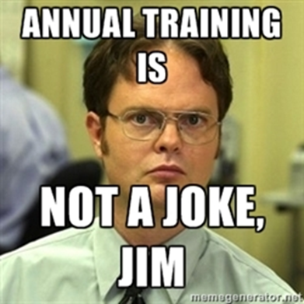
Training Required
Individuals selected to negotiate for both the board and the teachers are required to receive annual training on negotiations.
The content and format of the training is to be determined by the respective party each team represents in negotiations.
KASB workshops on negotiations would satisfy this requirement for the board’s team.
  Today!

Slide 39
K.S.A. 72-2228(f)
Those individuals selected by the board of education and the professional employees' organization to conduct negotiations pursuant to this act shall complete training on conducting negotiations each year. The content and format of the training for these individuals shall be determined by the respective party each individual represents in negotiations.

Slide 40
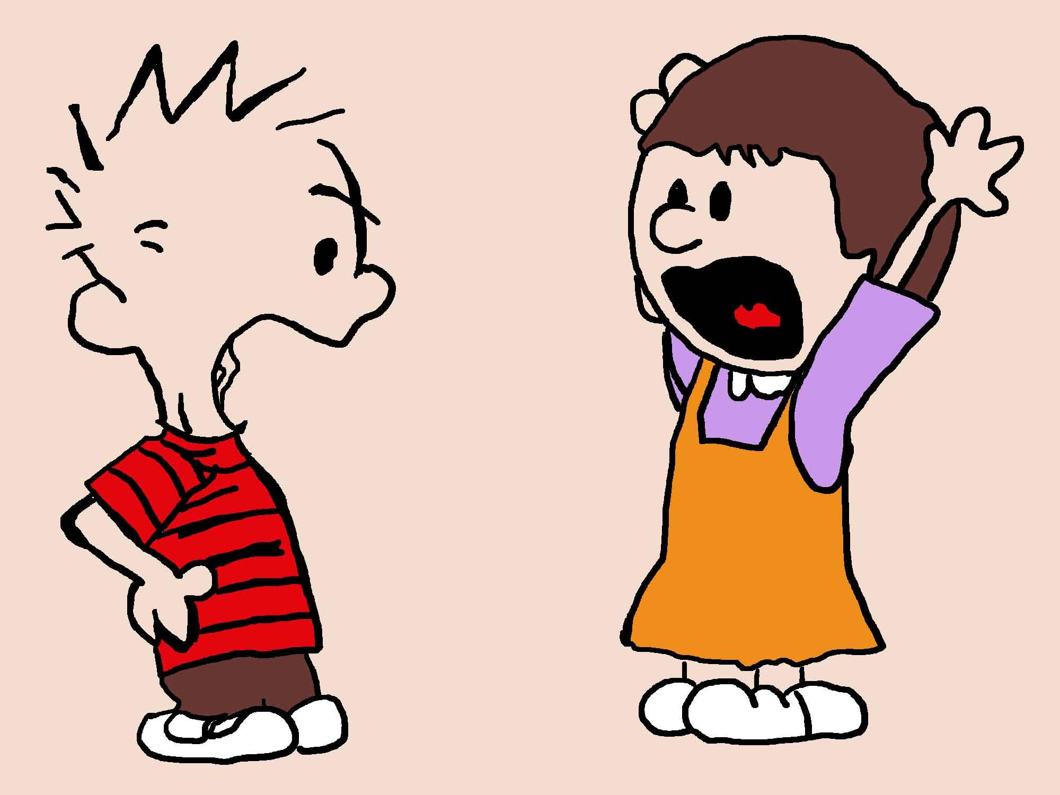
Responding to Difficult Arguments and Positions
Professional Employees have valid interests and concerns.
The board has legitimate interests to protect, as well.
  Respect the Employees’ position
  Explain the Board’s position and limitations
  Be factual, not emotional

Slide 41

Association Position No. 1
Association Argument: Teachers have not had a meaningful raise in years, and salaries are not keeping up with inflation.
How do you respond?

Slide 42

Association Position No. 2
Since the legislature took away due process, we don’t have the job security we believe we’re entitled to. We want to incorporate due process, exactly as it existed before it was repealed, by reciting the old statutory language in the agreement.
Response?

Slide 43

Association Position No. 3
Since salaries have been repressed, we want to shorten the contract year by three days to compensate for the lack of new income.
Response?

Slide 44

Association Position No. 4
We don’t like the McRel evaluation system and want to change to KEEP.
Response?

Slide 45

Association Position No. 5
Instead of raising the base and the amount in each cell by a dollar amount, we want the raise to be indexed, so that all teachers get the same percentage raise.
Response?

Slide 46

Questions?
Luke Sobba - lsobba@kasb.org
1-800-432-2471

